Slide 1
Eventing NSW Cross Country Jump Judges Briefing Technical Delegate - TD
Developed by Norm Hindmarsh TD

Slide 2
Thank you
On behalf of the Organising Committee,
and the Riders, I would like to start this
briefing by thanking you for giving up
your time to jump judge at the upcoming
event.
Without people doing this important task
the event would not run.
Thank you once again.

Slide 3
Where to sit/food and water/ toilet breaks
Where to sit
Ensure that you are safe and that no rider may accidentally ride into you.
If possible try to find shade and don’t sit too close to the jump, the horse needs to focus on the jump, not a person sitting close by.
Please sit in a position that you can easily see the riders number as it is coming towards you and as they go away from you.
Sit where you can see if a rider has a refusal or fails to go through the flags correctly. The horses head, neck and shoulders must pass between the flags.
If you are in doubt where to sit please ask the TD or a more experienced person
Remember to take a chair with you. (Some events can not allow jump judges cars on course.)
Food and Water
The Organising Committee has food and water organised for you. Please ensure you take your bag before you go out on course.
If you need more water radio the Course controller/TD
Toilet Breaks
If you need to go to the toilet please radio the Course controller/TD and wait to be relieved. This will done ASAP.

Slide 4
Your JOB
Observe
Note
Report
You are not alone, you are an important part of a team.
Your job starts when you get to your fence and the controller checks your
radio connection.
Your job finishes when released by the TD - normally when final results
have been published. If there is an objection you may be needed to assist
in resolving the matter.

Slide 5
Jump Judges Score Sheets
Each jump has a separate score sheet for each class and these are generally colour coded to the class and the colour on the fence e..g Pink is EvA-105 (Pre-Novice) and you would be judging a fence with a pink number.
A sheet looks like this:
ODE CROSS COUNTRY JUMP SHEET
Class: EvA 105 Colour: Black No on Pink Background |  |  |  |  |  |  |  |  | Jump Judges Name:
Jump No : |  |  |  | Please ensure Jump Number is filled in |  |  |  |  | Mobile No:
 | Clear | Refusal |  |  | Fall | Fall |  |  | Remarks
 |  | 1st | 2nd | 3rd | Rider | Horse
Rider |  | 20 | 40 | E | Elimination | Elimination | Missed jump | Total penalties
No. | √ | X | X | E | FR | FH | Out/assist | Office Use only

Slide 6
Filling out the Jump Sheet
Class eg One Star
Print your Mobile Phone (in case of a protest)
Yellow Numbers
Print Mobile Phone Number
ODE CROSS COUNTRY JUMP SHEET
Class: EvA 80 Colour: Black Number on White Background |  |  |  |  |  |  |  |  |  | Jump Judges Name:
Jump No : |  |  |  |  | Please ensure Jump Number is filled in |  |  |  |  | Mobile No:
 | Clear | Refusal |  |  |  | Fall | Fall |  |  | Remarks
 |  | 1st | 2nd | 3rd |  | Rider | Horse
Rider |  | 20 | 40 | E |  | Elimination | Elimination | Missed jump | Total
No. | √ | X | X | E |  | FR | FH | Out/assist | Penalties office use
Print Your Name
Print Jump Number
X Cross for fall of Rider
X Cross for fall of Horse
X Cross for 3rd disobedience
X Cross for 2nd disobedience
X Cross for 1st disobedience
Riders Number
(do not write all the numbers in the class down as riders may come out of order)
X Cross if the rider does not jump fence
X Cross if rider is given assistance by another person e.g. directions
√ Tick when jump correctly
Fell at part B
Jumped wrong class/colour
Other remarks e.g. Retired at C. PTO for diagram
Received assistance to find jump
Horse & rider fell at A

Slide 7
There are several forms of disobedience.
Refusal:
At obstacles or elements with height (exceeding 30cm), a horse is considered to have refused if it stops in front of the obstacle to be jumped.
At obstacles 30cm or less in height a stop followed immediately by a standing jump is not however penalised, but if the halt is sustained or in any way prolonged, this constitutes a refusal. The horse may step sideways but if it steps back this is a refusal.
After a refusal, if a competitor redoubles or changes his efforts without success, or if the horse is represented at the obstacle after stepping back and stops or steps back again, this is a second refusal; and so on.

Slide 8
A run out:
A horse is considered to have run-out if having been presented at an element or obstacle on the course, it avoids it in such a way that the head, neck and either shoulder of the Horse fail to pass between the extremities of the element or obstacle as flagged.
A rider is permitted to change his mind as to where he jumps an obstacle or element at any time, without penalty, including as a result of a mistake at a previous obstacle or element.
If, however, the horse avoids part of the obstacle at which it has been presented, 20 penalties are incurred.
When the distance between elements is 5 metres or less (a bounce), when the horse has negotiated the first element without penalty he will be deemed to have presented at the second element. If numbered as elements. Thus if an athlete ‘changes his mind’ while negotiating the first element of a ‘bounce’ and, for example, then goes another route he will still be penalised 20 penalties for a run-out. Note: This does not apply if separately numbered as obstacles.

Slide 9
A Circle:
At separately numbered obstacles, an Athlete may circle between or around them without penalty provided he has not presented his Horse at the second or subsequent obstacles.
After being penalised for a refusal, run-out or circle, an Athlete, in order to make another attempt, is permitted to circle one or more times without penalty, until he again presents his Horse at the obstacle
At an obstacle composed of several elements if the Athlete refuses, runs out or circles at any element, he is permitted to retake any elements already jumped, although he is liable to be penalised for any fault even if he has previously jumped an element successfully.
If after a refusal, run-out or circle, he wishes to pass through flags in the wrong direction in order to retake an element, he may do so without penalty.

Slide 10
A fall:
An Athlete is considered to have fallen when he is separated from his Horse in such a way as to necessitate remounting.
A Horse is considered to have fallen when, at the same time, both its shoulder and quarters have touched either the ground or the obstacle and the ground or when it is trapped in a fence in such a way that it is unable to proceed without assistance or is liable to injure itself.
All falls will always be penalised.
A fall of either the horse or rider is ELIMINATION.
Call in the fall (Rider No followed by jump No) on your radio
Don’t forget to mark your score sheet with the fall
PLEASE ASK THE RIDER TO WALK HOME VIA THE FINISH
If they are able. Both the rider and horse must be checked
by medical/veterinary personnel.

Slide 11
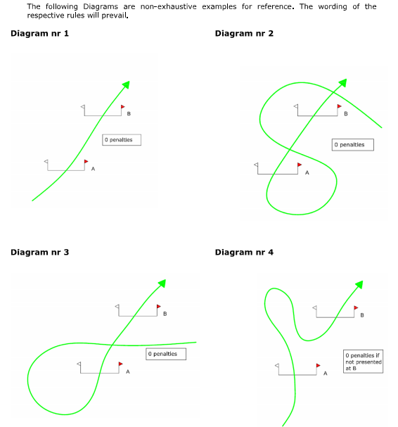
Diagrams of Cross Country Obstacles & Faults

Slide 12
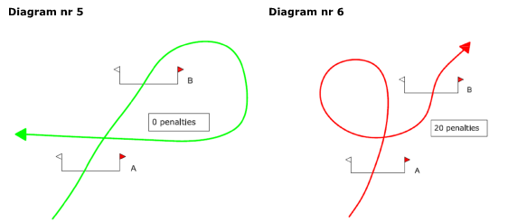
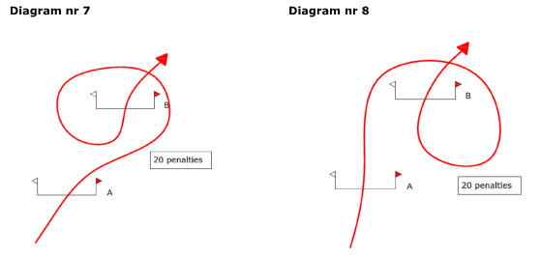
Diagrams of Cross Country Obstacles & Faults

Slide 13
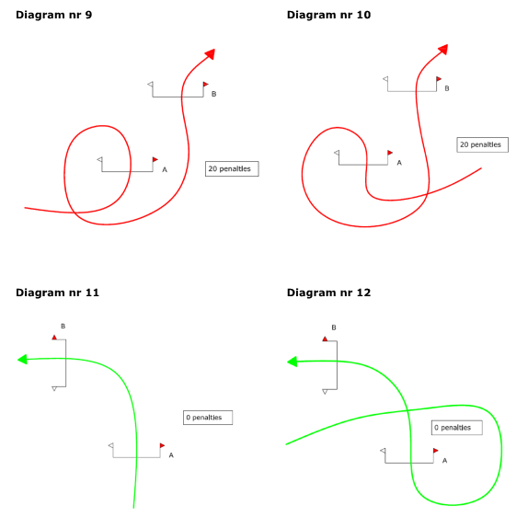
Diagrams of Cross Country Obstacles & Faults

Slide 14
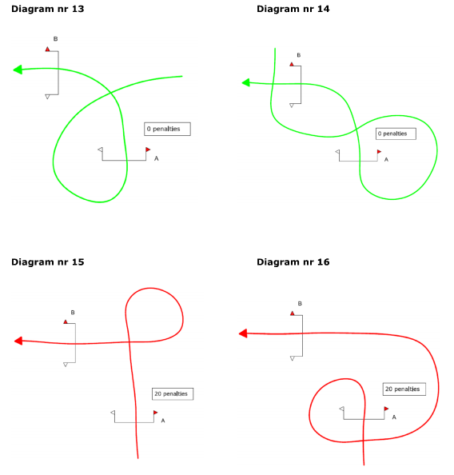
Diagrams of Cross Country Obstacles & Faults

Slide 15
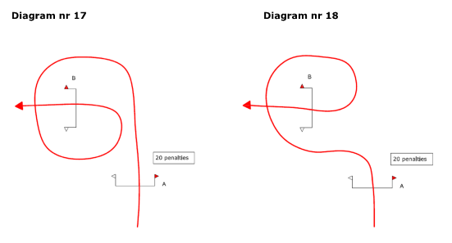
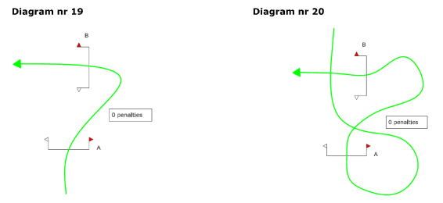
Diagrams of Cross Country Obstacles & Faults

Slide 16
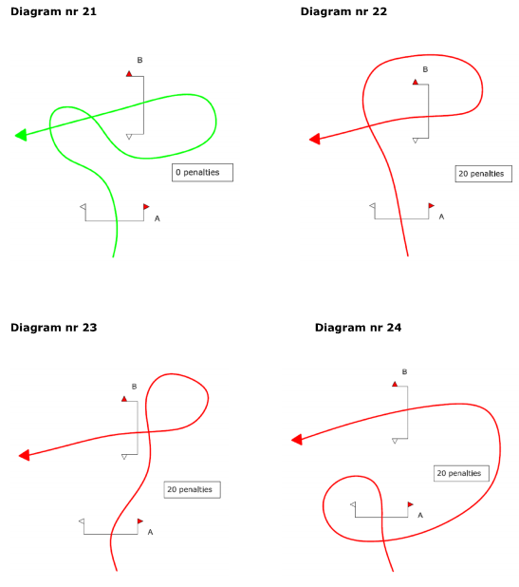
Diagrams of Cross Country Obstacles & Faults

Slide 17
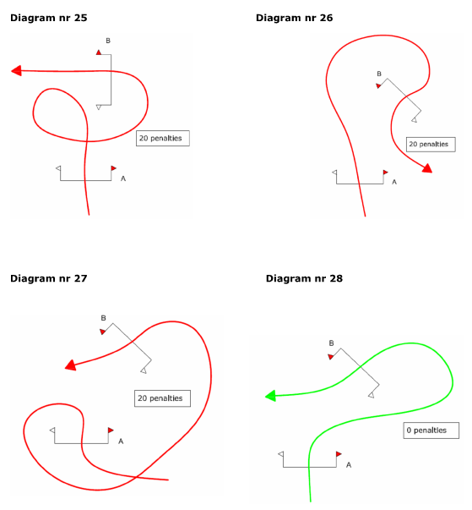
Diagrams of Cross Country Obstacles & Faults

Slide 18
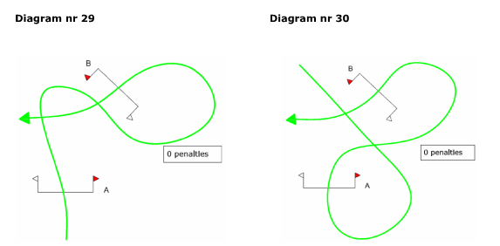
Diagrams of Cross Country Obstacles & Faults

Slide 19
Doubt over whether a rider has had a disobedience
If you have any doubt whether a rider has had a disobedience or for anything you may feel is unclear please immediately turn your score sheet over and draw sketch of what you believe occurred.
This is very useful in sorting out possible problems later in the day.
Also radio the Course controller/TD briefly at the time of the problem.

Slide 20
Jump Judge Instructions to riders.
A rider may ask a jump judge for clarification if they feel they may have missed a flag etc. The Jump Judge has the responsibility to clearly and loudly inform the rider of their judgment. Please make this loud and clear!
You must be prepared to advise a rider, if he asks, what decision you have made regarding passing within the flags. He then can retake the jump or continue on.
A Jump judge does not eliminate riders, they report disobediences, refusals, circles, falls, etc to the course controller or TD. These officials may then eliminate the rider and you may be asked to stop the athlete and send them home, via the finish.
If a rider has a refusal or circle etc please count them out loud for his benefit “one refusal”, “two refusals” etc - this could save many discussions later.
Be clear, fair and consistent

Slide 21
Reporting disobediences or falls
When you have had a disobedience at your fence please radio this to the Course Controller or TD ASAP
All disobediences, run-outs, circles, falls, MUST be ‘called in’ using the radio.
Please follow this format:
Rider Number
Jump Number
Number of disobediences
E.g.
Rider number 56
Jump Number 6
2 refusals
Clear 3rd attempt
Or
Rider number 34
Jump number 7
Rider fall
Course is clear- rider & horse okay or Course is blocked - Please send Medical & Veterinary personnel.

Slide 22
Fallen Rider or Horse & Rider
If this this occurs at your fence remain calm and
carry out the following.
Assess the situation.
Is it a major fall of horse and/or rider?
Does either the rider or horse or both need medical/vet assistance?
Is the course clear?
Radio the fall and your assessment immediately to the course controller (It may be necessary for the course controller or TD to stop the course, pending your advise to them regarding the situation).
Give assistance to rider or horse, ensure you take your radio with you.
Stop on coming rider, in a safe manner, (or have others do this) Note the time you stop this horse. Or call into control as you stop the rider
Remain close to the radio and liaise with the Course controller/TD and other officials if the ambulance, vet or fence repair team (crash crew) are needed.

Slide 23
Radios
Please ensure you have a working radio and that it is on the correct Channel.
The radio is only to be used for official communications.
How to use the radio
Press the side button
Think
Slowly and clearly give your message
Think - was the message correct
Release button.
Do not put the radio in your pocket, use the lanyard
provided.
Do not leave your radio or put it down.
If you have further questions see the TD or another experience person

Slide 24
Stopping and starting riders
If you have to stop a rider either due to a fall at your fence or as a request from the course controller or TD, ensure you do this safely and record the time immediately when you ask the rider to stop. Don’t wait until the horse has stopped.
And call into control as you stop the rider.
RECORD THE TIME WHEN YOU STOP A HORSE
If you do not have a Timesaver clock, or the elapsed time app on a mobile phone record the time of day from your own watch or mobile phone. The scorer will do the maths!
RECORD THE STOPPING TIME e.g. 10:23:45 (in the remarks column)
RECORD THE STARTING TIME e.g. 10:49:07 (in the remarks column)
Sometimes you will not have to restart a horse, the TD or another official will do this however they will need your watch/clock or mobile for the time.
The time a horse starts is recorded when the horse has resumed cantering.
A rider may request a warm up jump, of a lesser grade if possible, before resuming. Talk to control on the radio for more advise.
It is clearly intended that the time shall be taken as the Athlete gallops post the timing point, not after he halts nor after a start from the halt.

Slide 25
Score Sheets
At the end of each class a person will collect the score sheets.
Please do not move from your fence until the score sheet is collected.
Once the score sheet is collected please move as quickly as you can to the next fence you are to judge.

Slide 26
Radio Checks
Before each class begins the Course controller/TD will do a call around (Radio check) on the radios to ensure all jump judges are in position. Please answer this as quickly as possible so we may get the next class started ASAP
Do not put your radio down even between classes.

Slide 27
Further Questions
If you have any further
questions please feel
free to ask for assistance
from the TD or other
Officials.

Slide 28
Thank you again
Thank you once again for your invaluable assistance, volunteers like yourself are Very Important People

